Slide 1
LinkedIn
Rachael Deja and Bryan Strawter

Slide 2
What is LinkedIn?
A Professional…
Platform
Social network
Playground
Notes:
- Used to build networks and gain connections

Slide 3
What is LinkedIn?
A hybrid of
Resume
Website
Facebook profile
Blog
Notes:
- Used to build networks and gain connections

Slide 4
What is LinkedIn?
A complete presentation of who you are, what you’ve achieved and what you’ve done professionally.
Notes:
- Used to build networks and gain connections

Slide 5
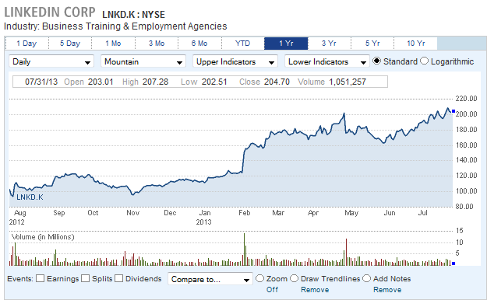
Fun Stats
LinkedIn since the last year has doubled its stock share prices. This July the share was as high as $208.53 versus last August which was priced at $111.55
http://data.cnbc.com/quotes/LNKD/tab/2

Slide 6
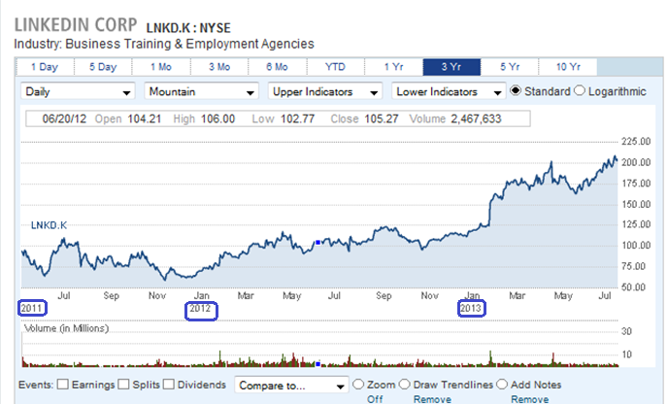
3 Year look
http://data.cnbc.com/quotes/LNKD/tab/2

Slide 7
Why the increase?
Some reasons for the increase in popularity in LinkedIn can vary from:
Increasing need of Information Technology in jobs today
Social Media feel to it that most of us are used to by now
Mostly used as an online public Resume for companies to browse at

Slide 8
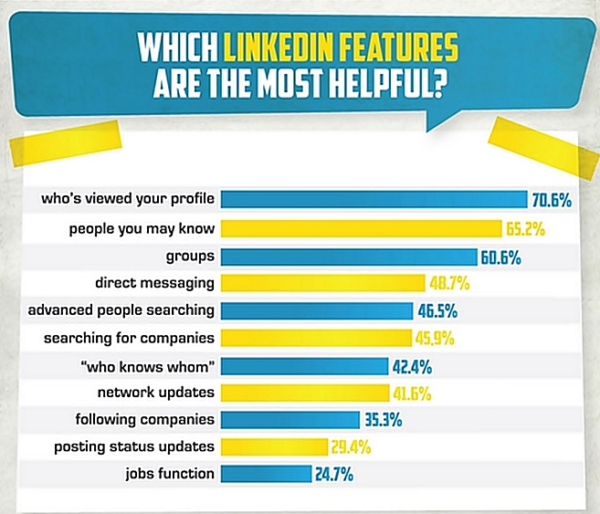
http://socialbarrel.com/wp-content/uploads/2013/07/The-Portrait-Of-A-LinkedIn-User-%E2%80%93-2013-Infographic.jpg

Slide 9
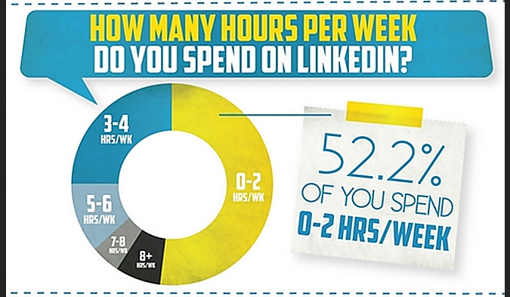
http://socialbarrel.com/wp-content/uploads/2013/07/The-Portrait-Of-A-LinkedIn-User-%E2%80%93-2013-Infographic.jpg

Slide 10
Social Media as a whole:

Slide 11
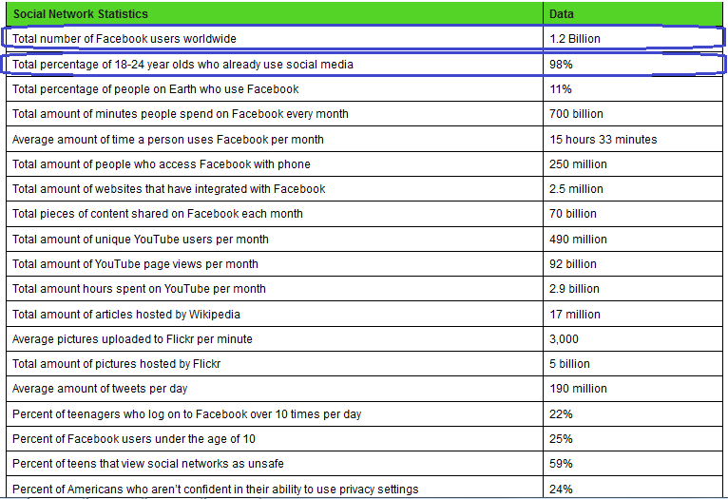
Social Media cont..
http://www.statisticbrain.com/social-networking-statistics/

Slide 12
How it Works
A profile reads like a professional resume where the focus is on education and experience.

Slide 13
How it Works
During the registration process you’ll be asked for….
Name
Email
Location
Current Employer
Past Employers
Education (College)

Slide 14
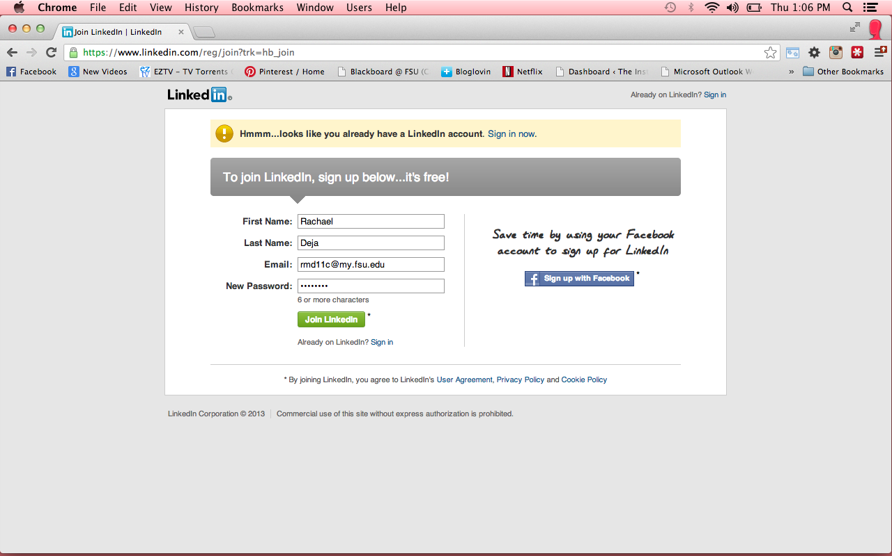

Slide 15
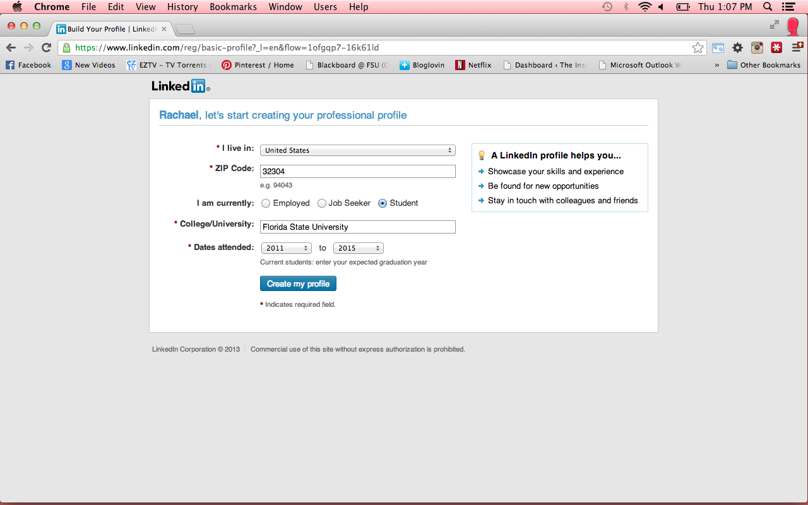

Slide 16
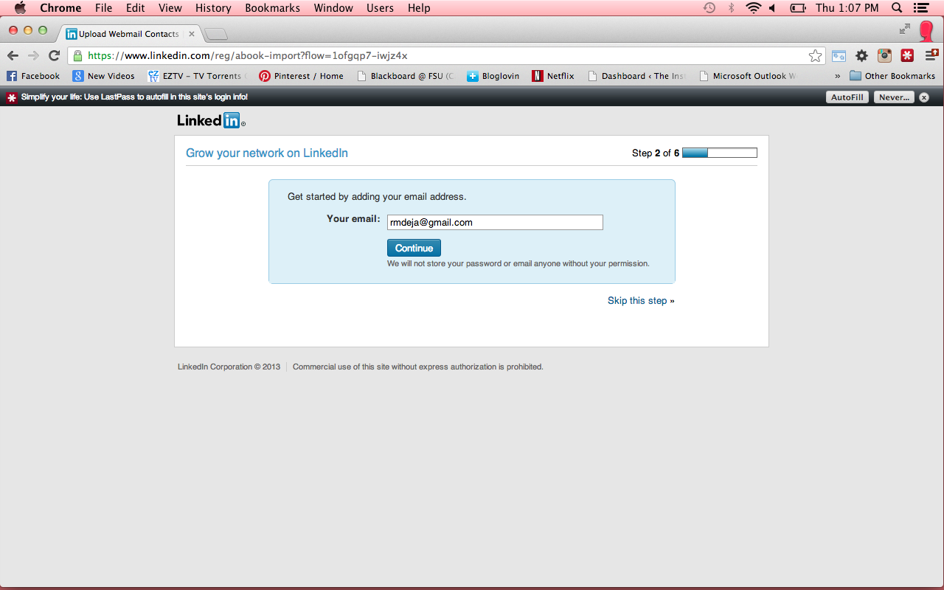

Slide 17
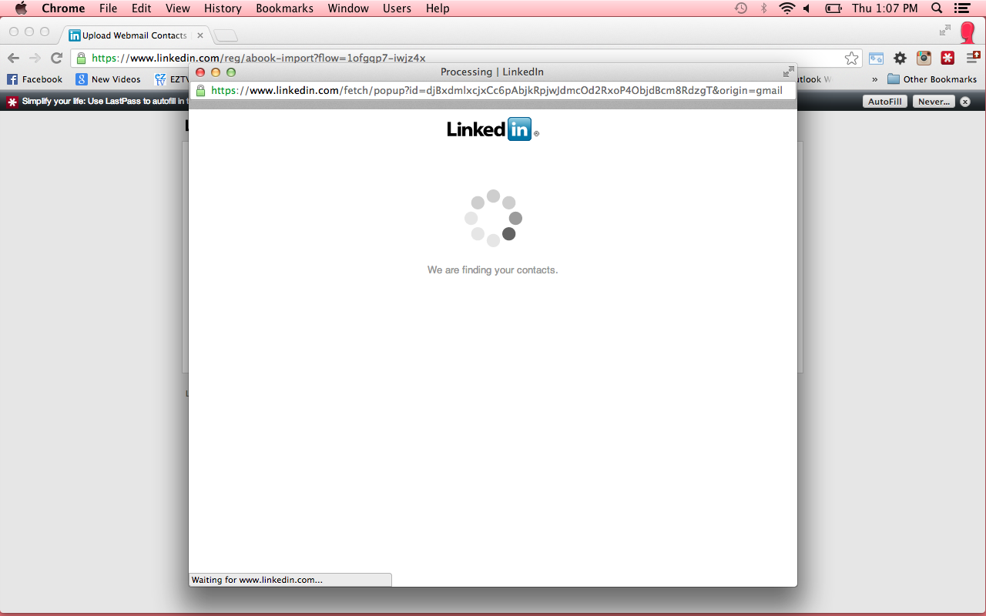

Slide 18
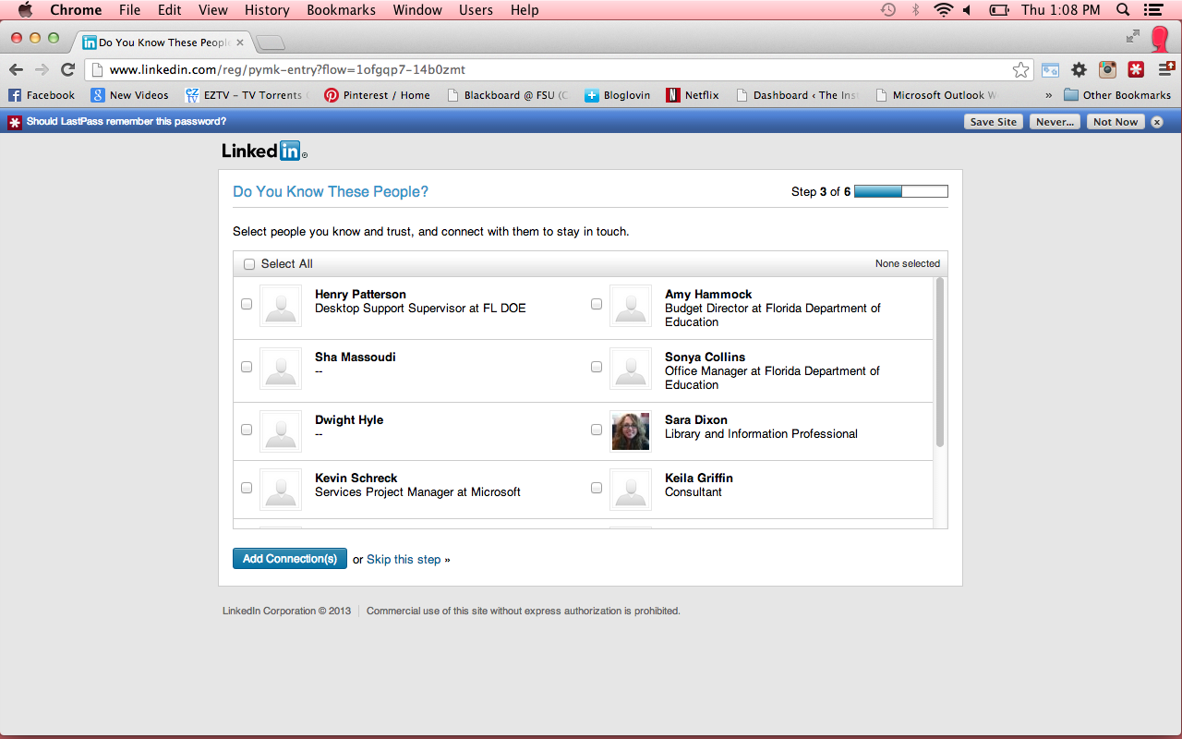

Slide 19
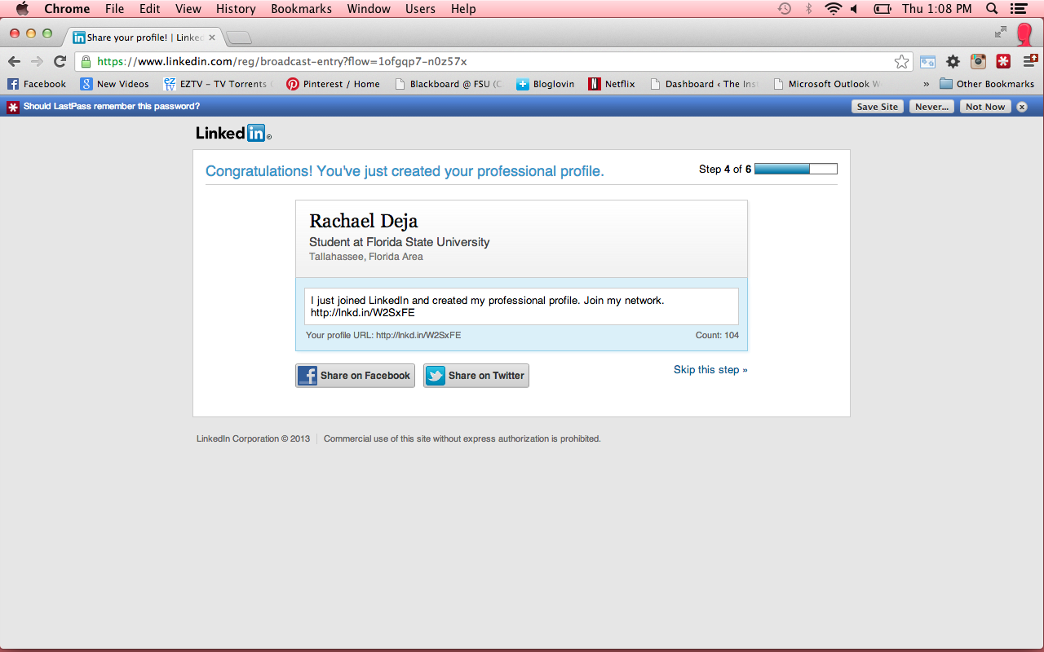

Slide 20
How it Works
Once registered, you will be asked for more detailed information on your profile.

Slide 21
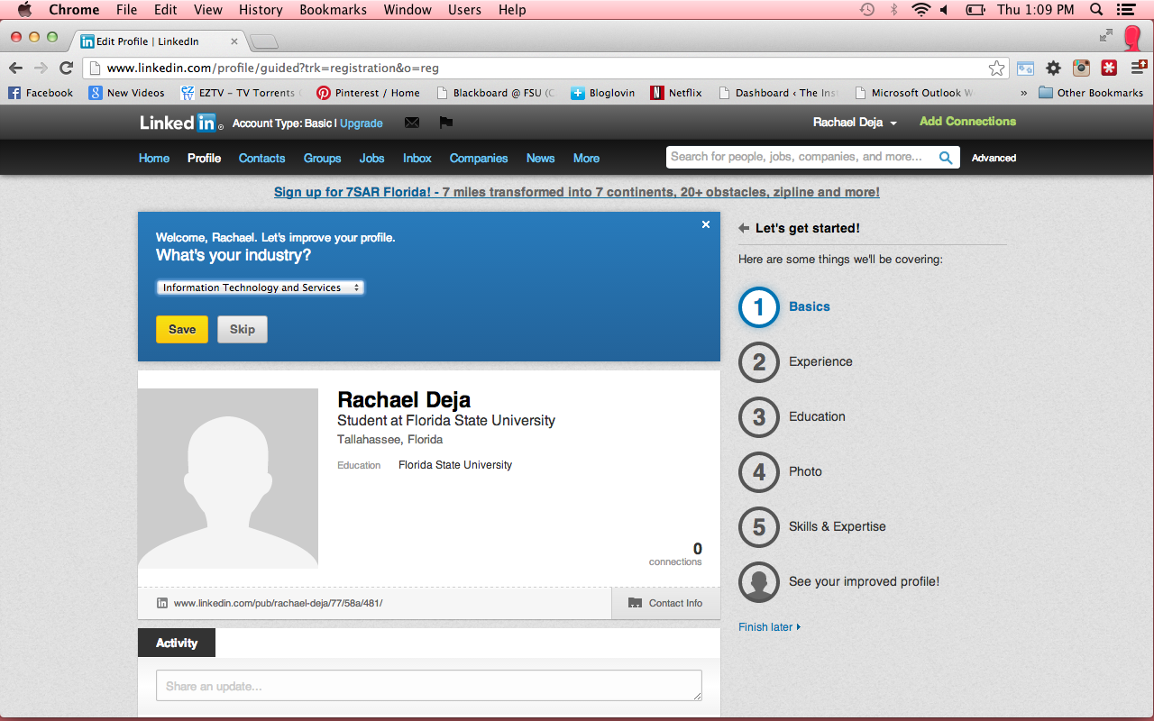

Slide 22
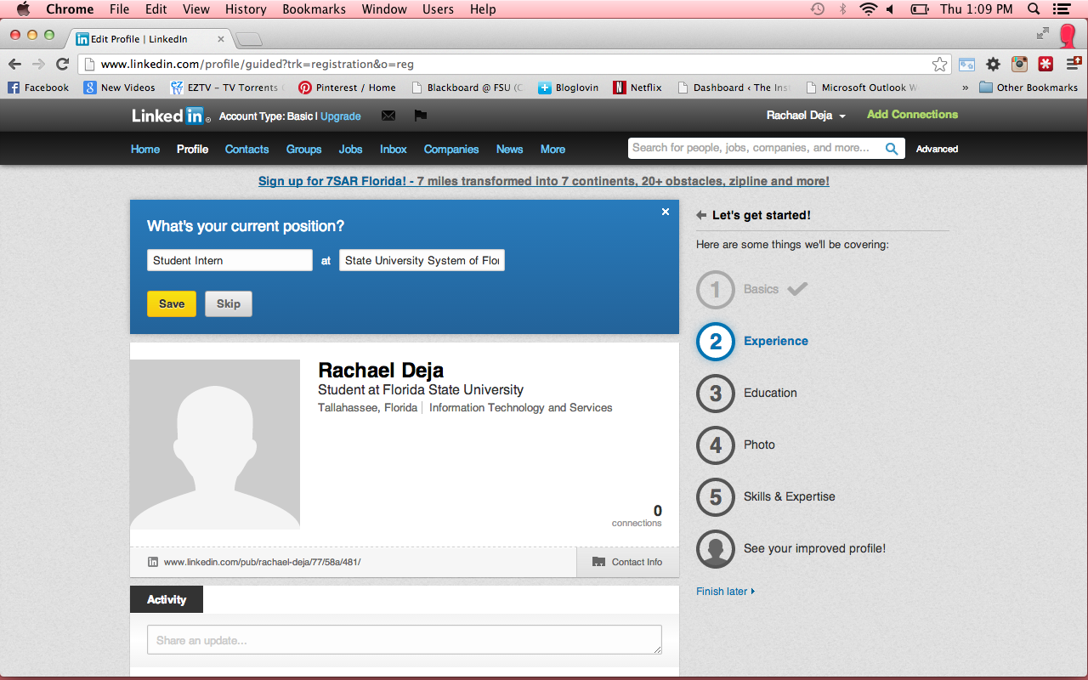

Slide 23
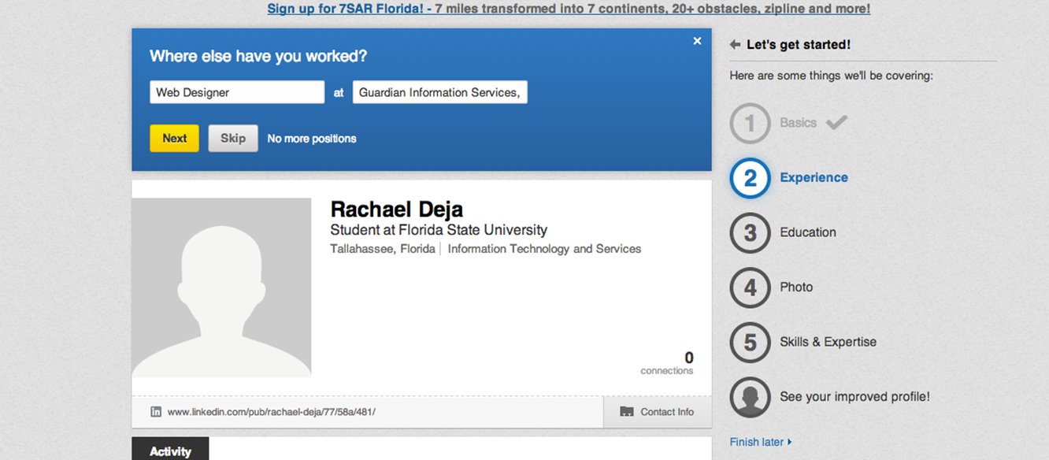

Slide 24
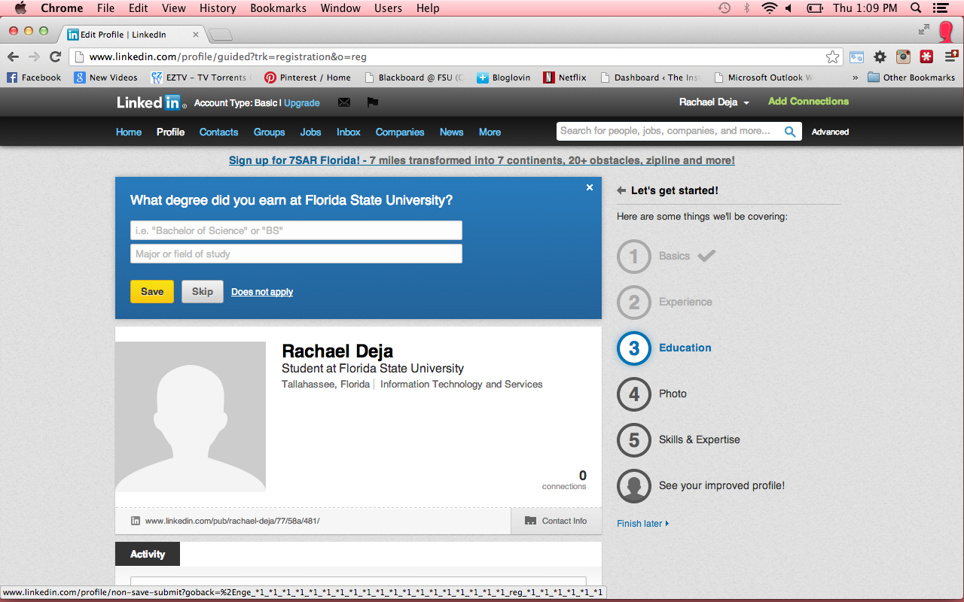

Slide 25
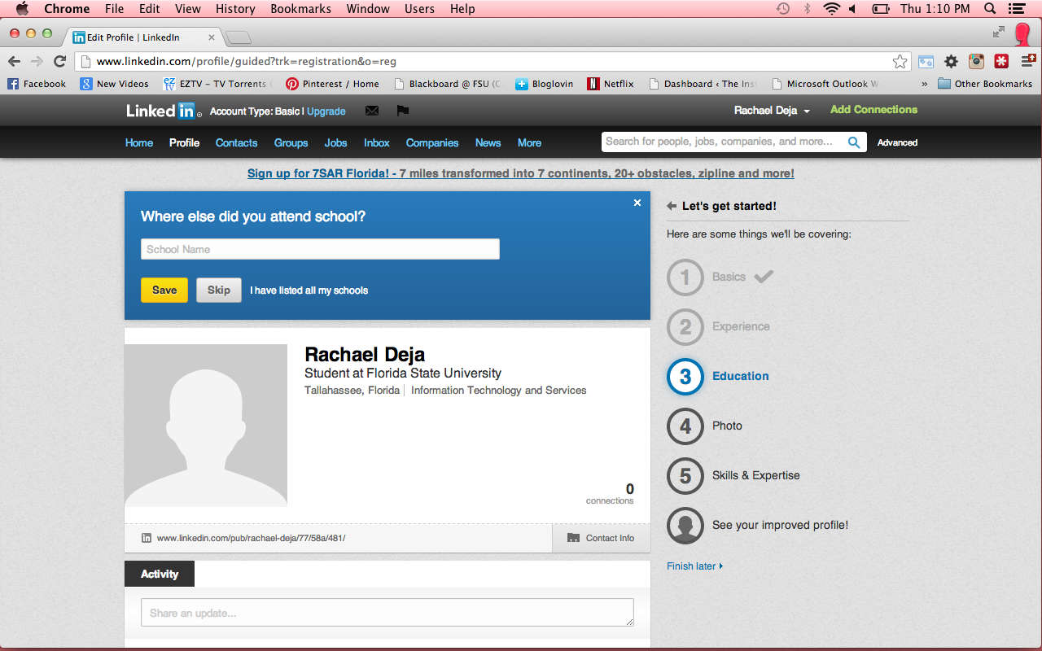

Slide 26
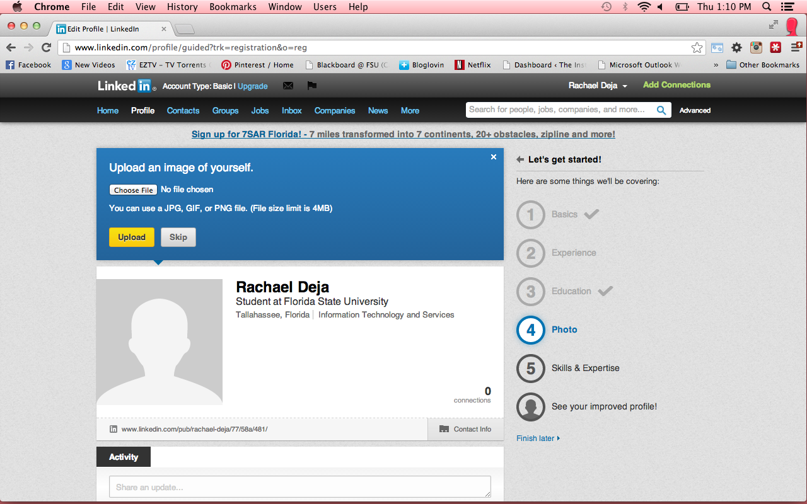

Slide 27
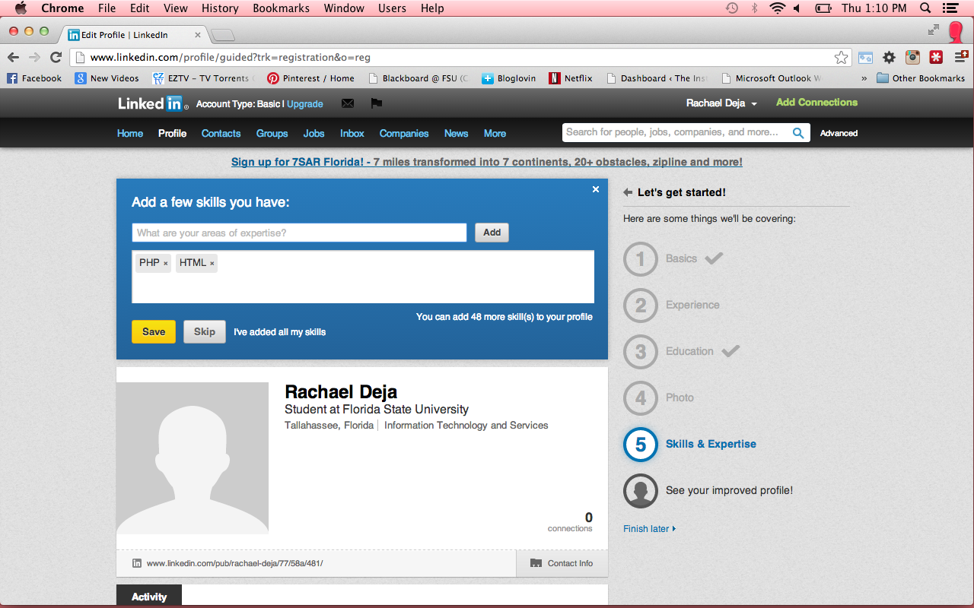

Slide 28
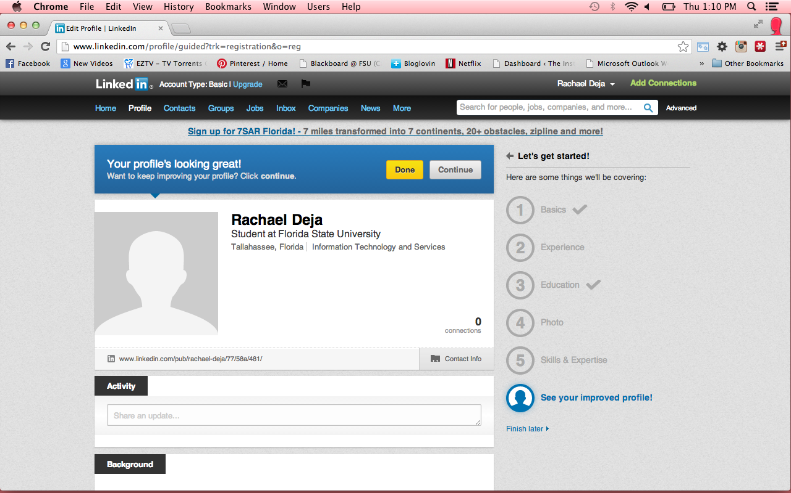

Slide 29
How it Works
Once all the information has been entered LinkedIn begins to data mine

Slide 30
How it Works
It’ll know who to connect you with
Colleagues
Past colleagues
Bosses
Classmates
Friends
“Friends of Friends”

Slide 31
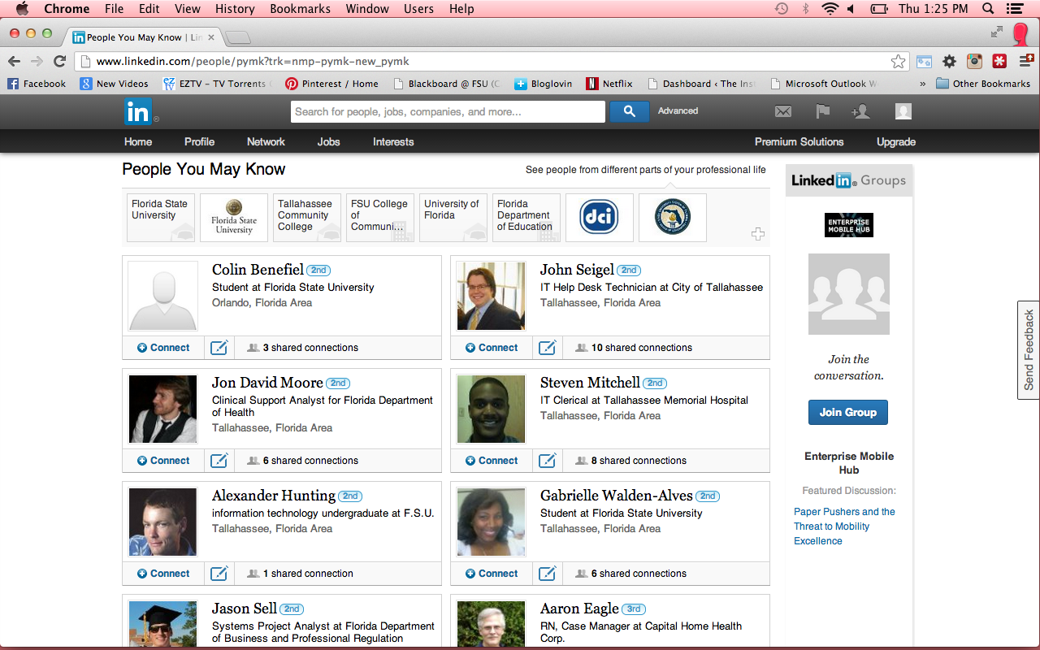

Slide 32
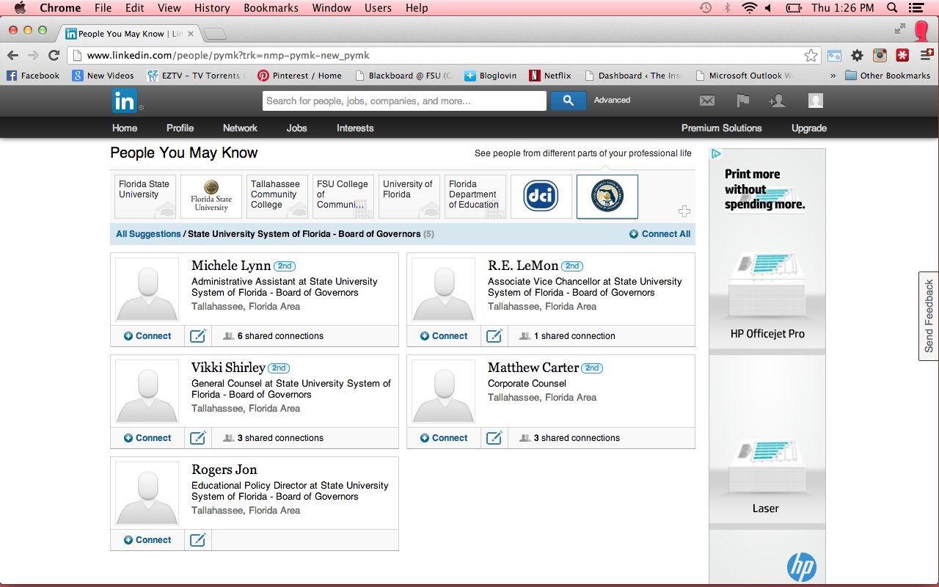

Slide 33
Brand Yourself
Use your resume to get connections!
Use your connections to get..
Recommendations
Endorsements (confirmation of your skills)

Slide 34
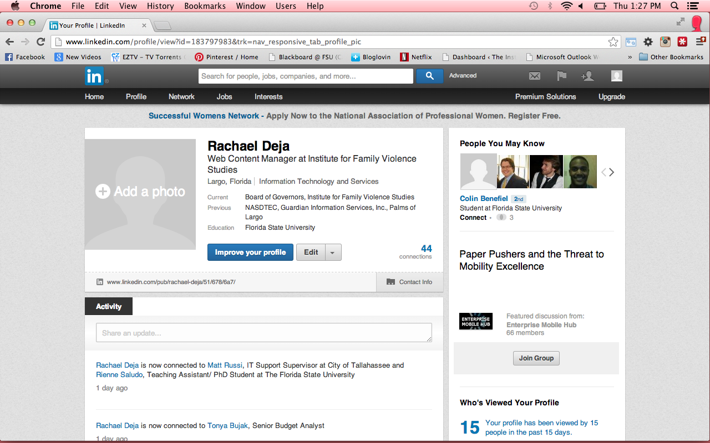

Slide 35
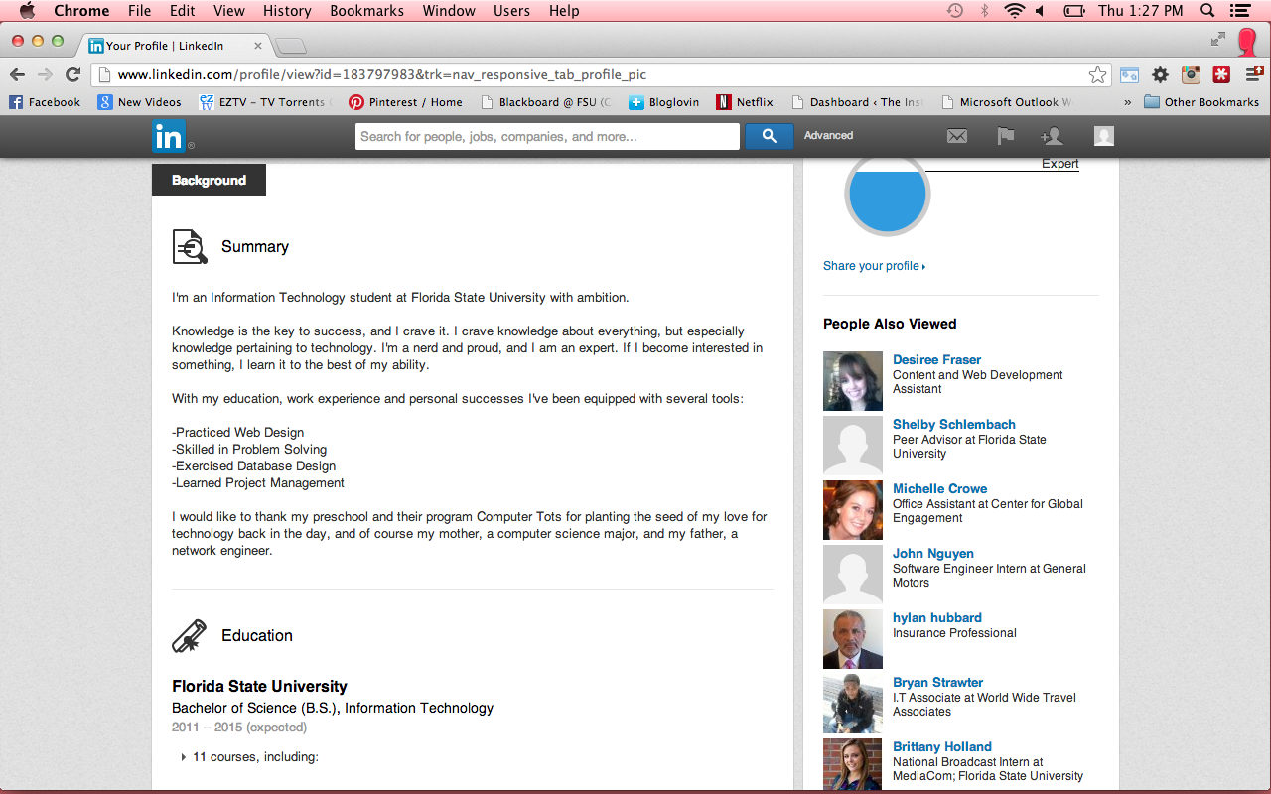

Slide 36
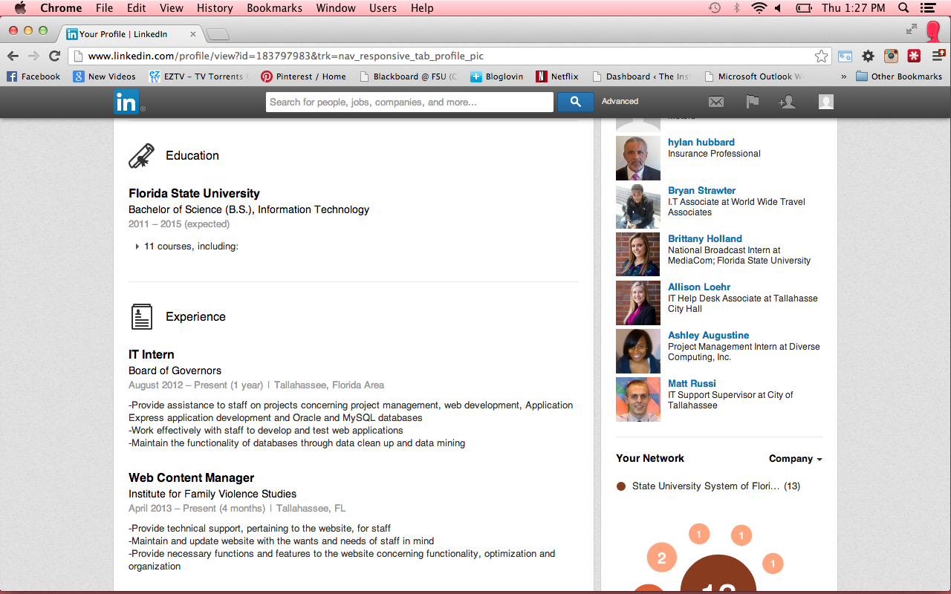

Slide 37
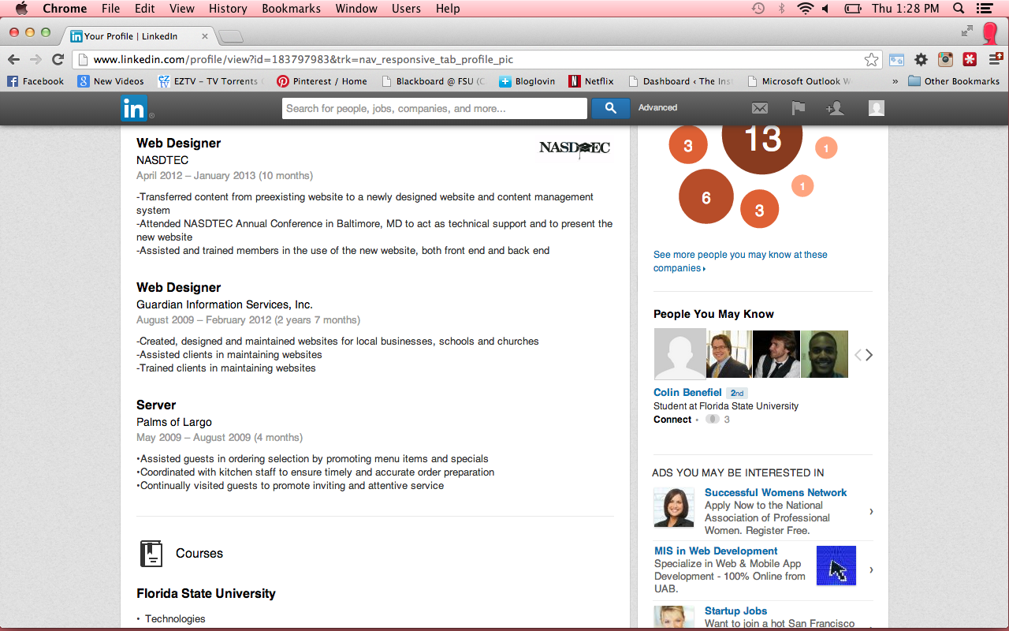

Slide 38
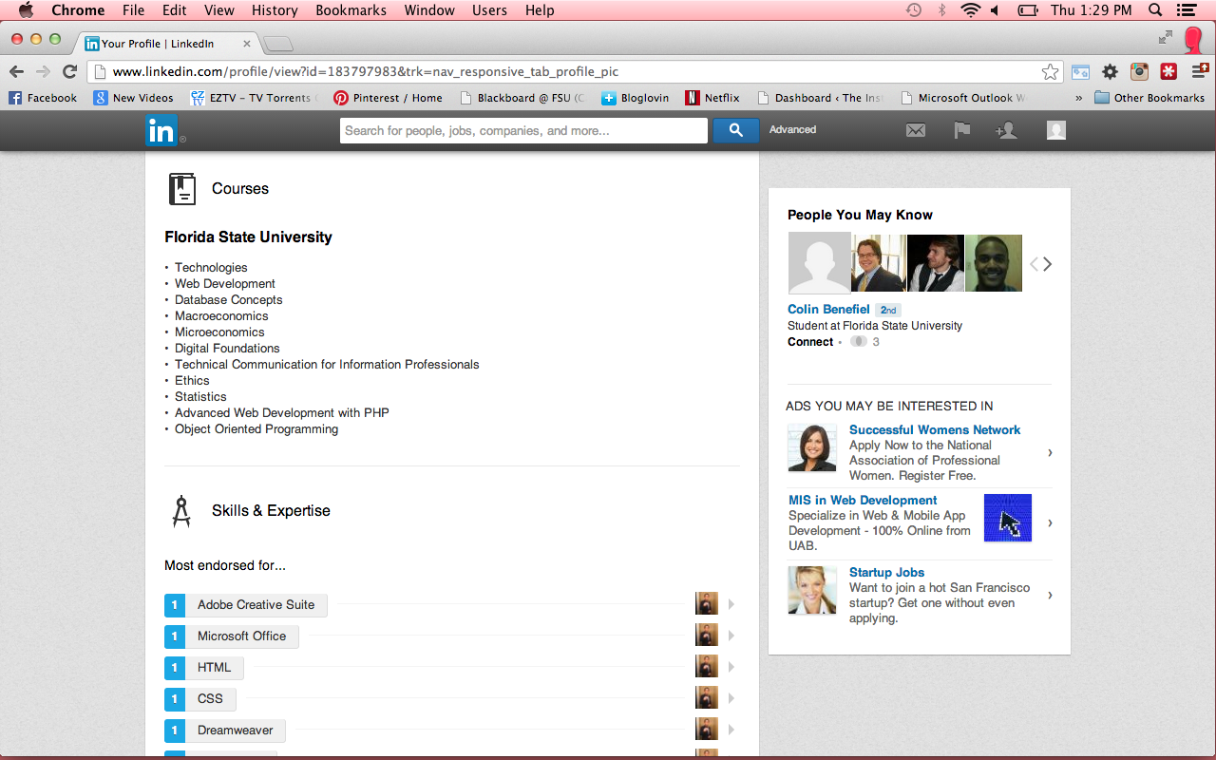

Slide 39
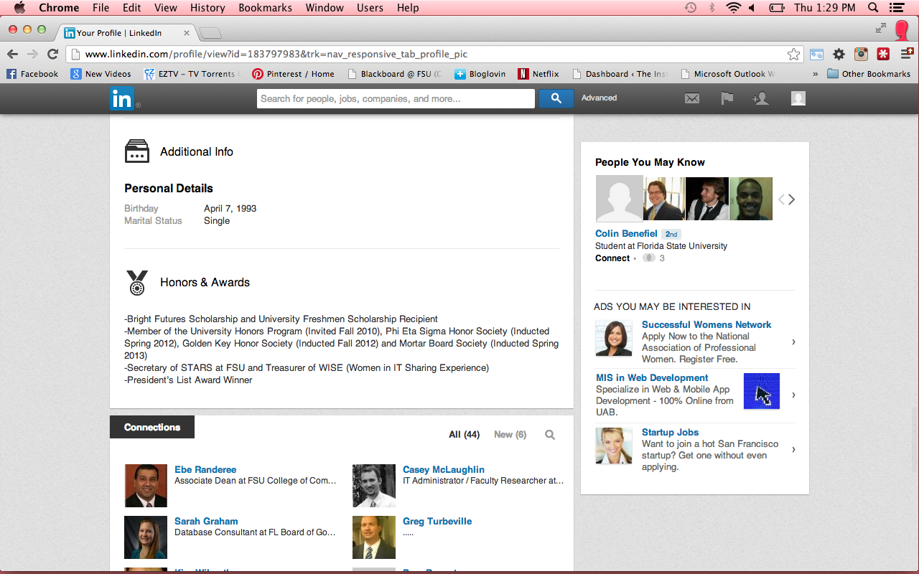

Slide 40
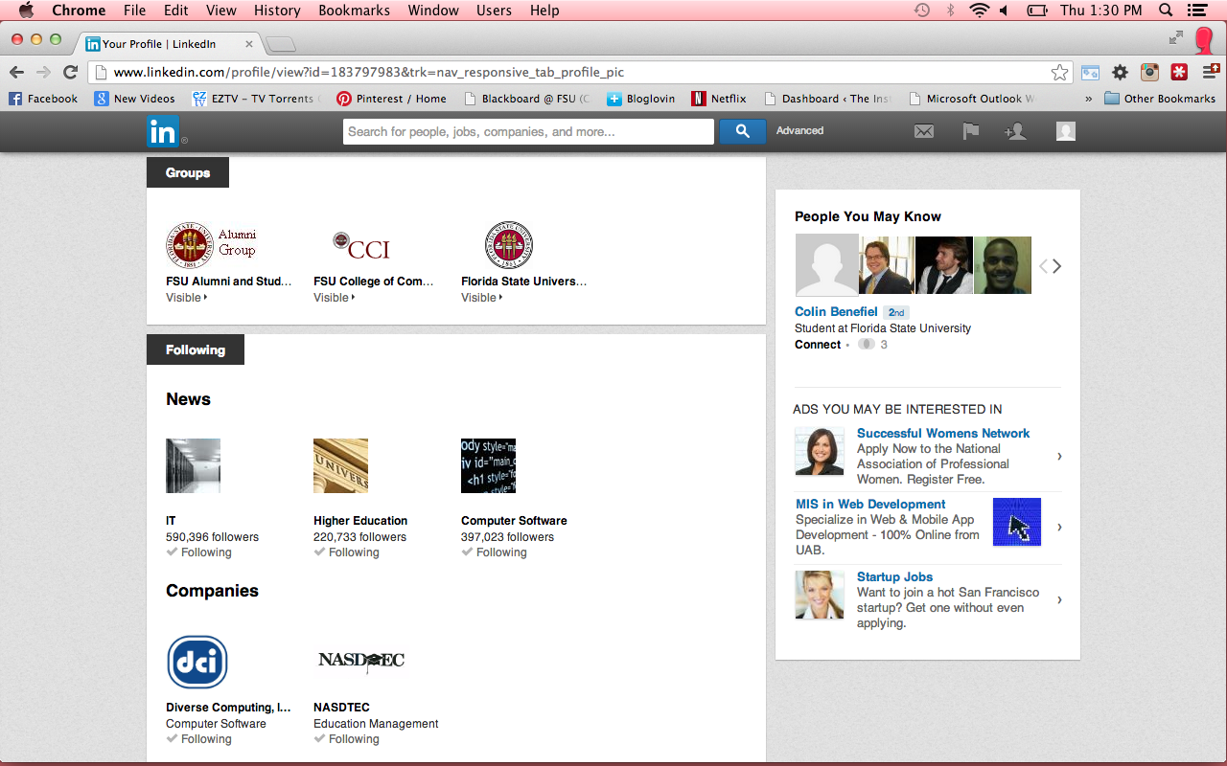

Slide 41
Growing Your Network
Business cards are a thing of the past
Information changes
People move on

Slide 42
Finding Jobs
Get the word out
Get LinkedIn recommendations from your colleagues

Slide 43
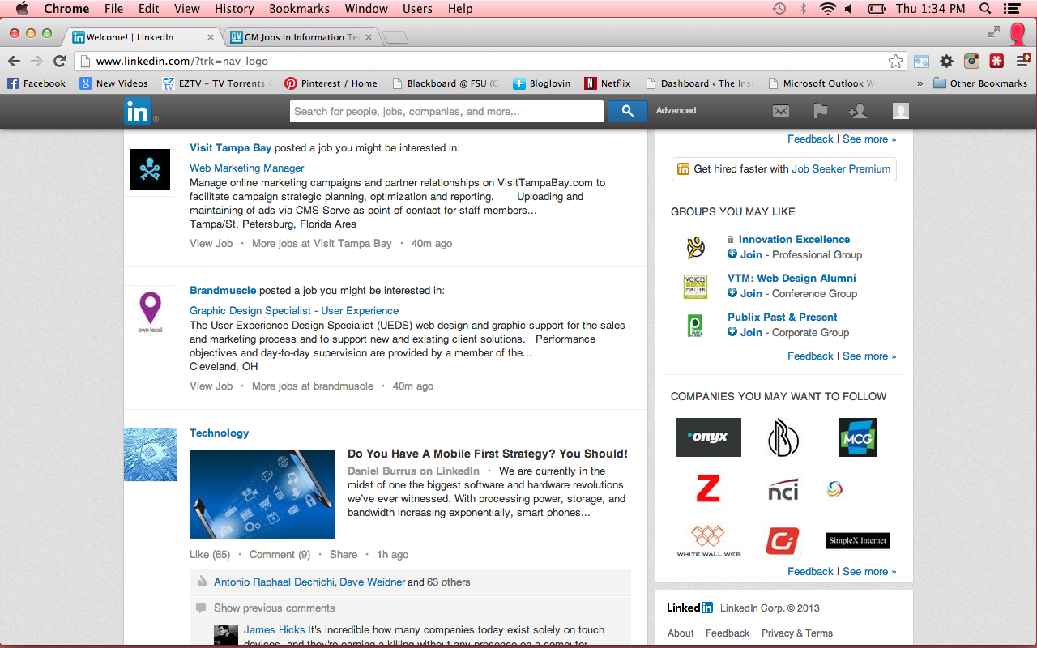

Slide 44
Finding Jobs
Find out where people with your backgrounds are working
Find out where people at a company came from

Slide 45
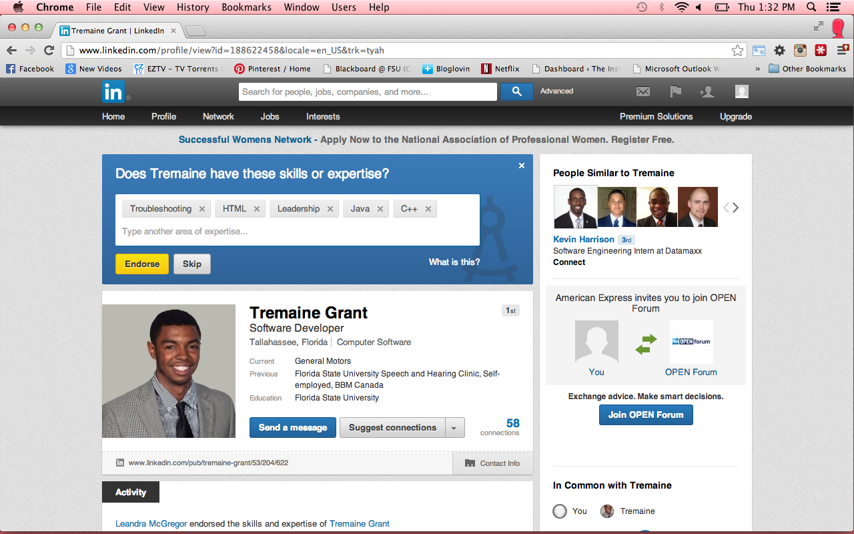

Slide 46
Finding Jobs
Find out where people from a company go next
Check if a company is still hiring

Slide 47
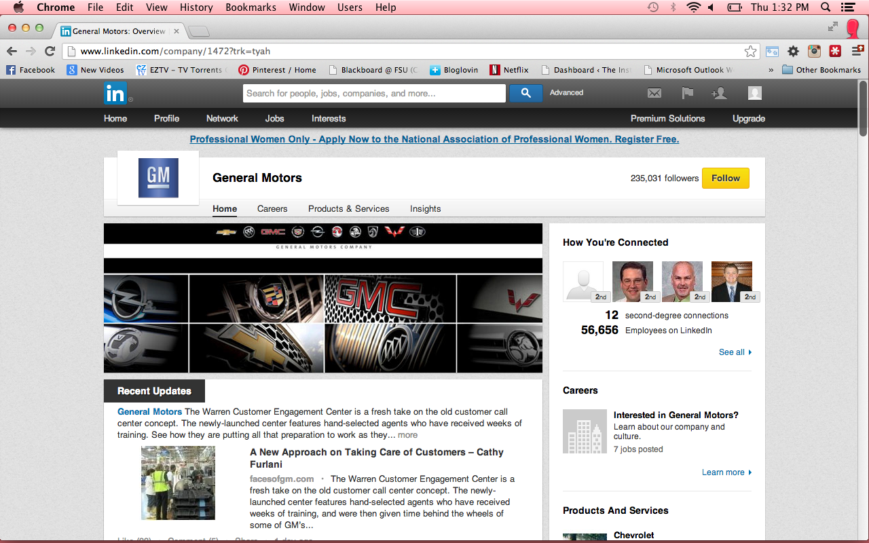

Slide 48
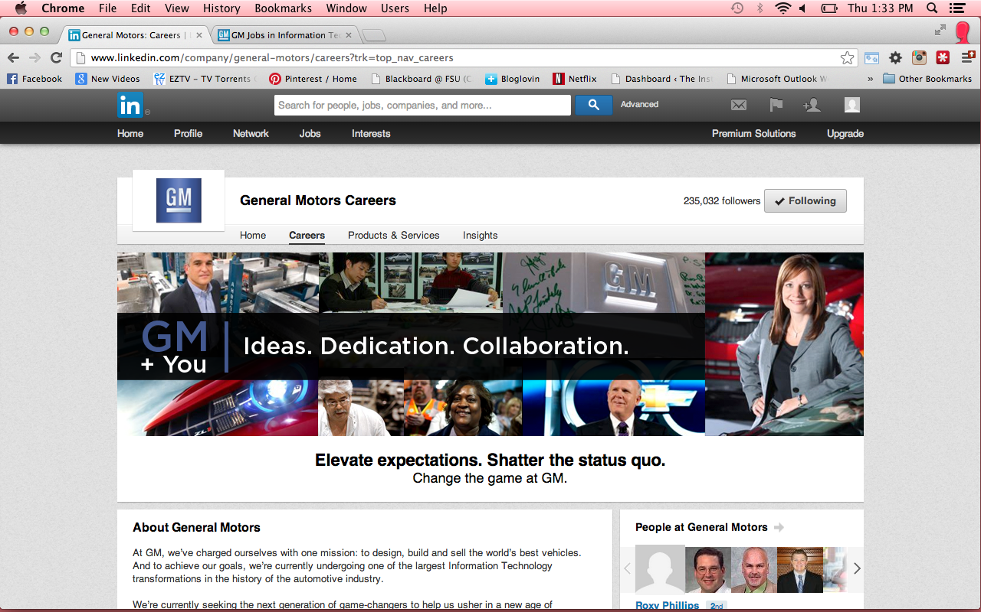

Slide 49
Why to use LinkedIn
Increase your visibility
Improve your connectability
Enhance your search engine results

Slide 50
Why to use LinkedIn
Perform blind, “reverse”, and company reference checks
Increase the relevancy of your job search

Slide 51
Why to use LinkedIn
Make your interview go smoother
Gauge the health of a company
Gauge the health of an industry

Slide 52
Why to use LinkedIn
Track startups
Ask for advice

Slide 53
Why to use LinkedIn
Gather useful information on a specific job you are looking for

Slide 54
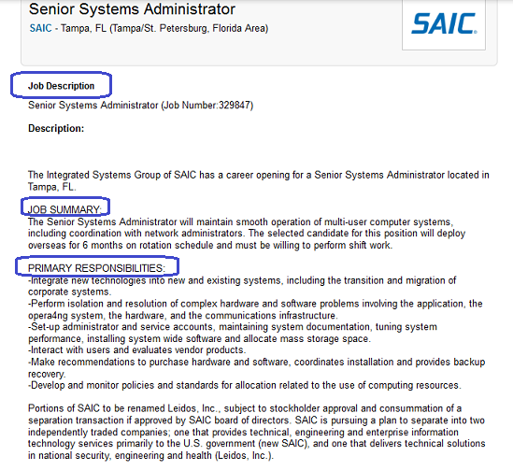

Slide 55
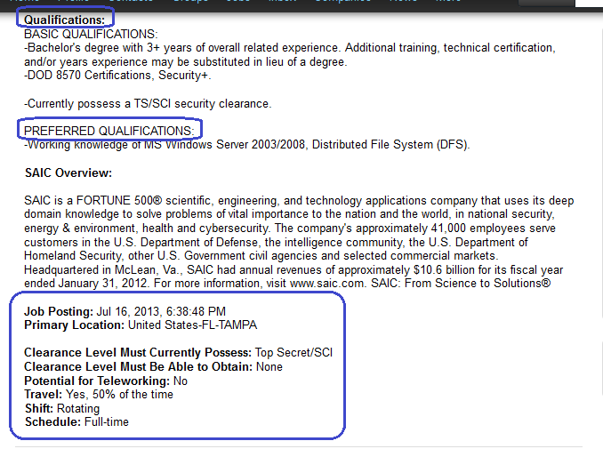

Slide 56
Conclusion
Today we looked at who uses, why use, and how to use LinkedIn all which are very important in todays technology driven work world.

Slide 57
Bottom Line
Advertise yourself
Put your self out there to be found
If someone wanted more information pertaining your work skills and previous work history they would have a detailed profile which they can find right on LinkedIn about what you are doing and your background.

